Slide 1
DEMO: How to set up and use AI enricher to fill in gaps in data
Using AI to enrich your records and transform incomplete data into valuable insights

Slide 2



Session Goal
This session is part of a series of practical trainings on using CluedIn AI, AI enricher in particular, for data management.
Your CluedIn Trainer will demonstrate how to set up and use an AI enricher to analyze a dataset and automatically fill gaps in data using existing information.
Note: This session is designed to develop practical experience with AI enricher. For details about the enricher’s features and capabilities, refer to the AI enricher overview session.

Slide 3


The data we’ll use
We are working with HavenStay Hotels, a fictional international hotel chain.
The challenge? Some of the data is missing, and filling those gaps manually would require significant time and resources.
Hotel data:
Regional hotel addresses, without a country specified
Each hotel requires a summary of the facilities it offers
The summary must be localized into multiple languages

Slide 4
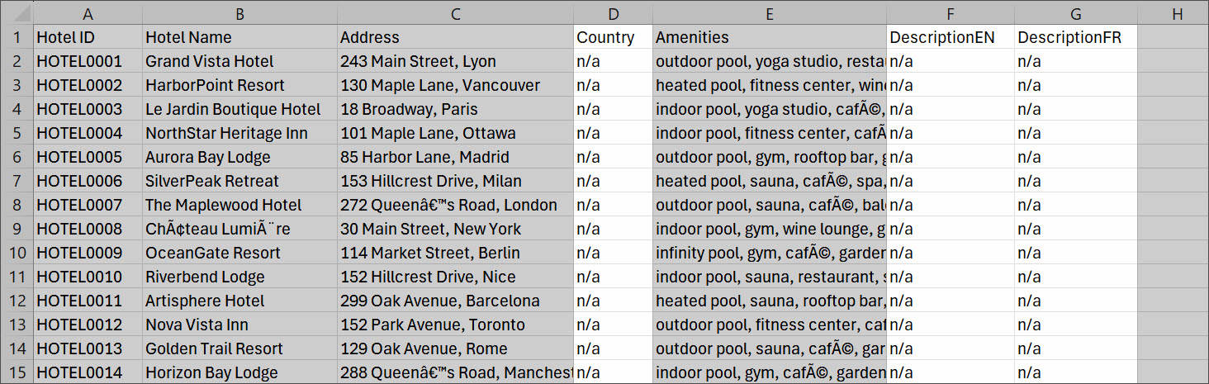

Slide 5


#6B7280
#6B7280
After
Before
HOTEL.ADDRESS
HOTEL.ADDRESS
173 Cedar Street, Montreal
173 Cedar Street, Montreal
ENRICHER
AI
HOTEL.COUNTRY
Canada

Slide 6
#6B7280
After
HOTEL.AMENITIES
infinity pool, sauna, café, spa, room service, laundry service, conference center, on-site parking, pet-friendly
#6B7280
HOTEL.DESCRIPTION (EN)
Located in the vibrant city of Montreal, Canada, this exceptional hotel offers guests a luxurious experience with a wide range of premium amenities. Enjoy relaxation and stunning views in the infinity pool, unwind in the sauna and spa, or savor delicious treats at the on-site café. The hotel also features convenient room service, professional laundry service, a state-of-the-art conference center for business needs, and on-site parking for added comfort. Plus, pet-friendly accommodations ensure every traveler can bring their companions along, making it the perfect choice for both leisure and business visitors to the heart of Montreal.
Before
HOTEL.AMENITIES
ENRICHER
infinity pool, sauna, café, spa, room service, laundry service, conference center, on-site parking, pet-friendly
AI

Slide 7
#6B7280
After
HOTEL.DESCRIPTION (EN)
Located in the vibrant city of Montreal, Canada, this exceptional hotel offers guests a luxurious experience with a wide range of premium amenities. Enjoy relaxation and stunning views in the infinity pool, unwind in the sauna and spa, or savor delicious treats at the on-site café. The hotel also features convenient room service, professional laundry service, a state-of-the-art conference center for business needs, and on-site parking for added comfort. Plus, pet-friendly accommodations ensure every traveler can bring their companions along, making it the perfect choice for both leisure and business visitors to the heart of Montreal.
#6B7280
Before
HOTEL.DESCRIPTION (EN)
Located in the vibrant city of Montreal, Canada, this exceptional hotel offers guests a luxurious experience with a wide range of premium amenities. Enjoy relaxation and stunning views in the infinity pool, unwind in the sauna and spa, or savor delicious treats at the on-site café. The hotel also features convenient room service, professional laundry service, a state-of-the-art conference center for business needs, and on-site parking for added comfort. Plus, pet-friendly accommodations ensure every traveler can bring their companions along, making it the perfect choice for both leisure and business visitors to the heart of Montreal.
HOTEL.DESCRIPTION (FR)
ENRICHER
Situé dans la ville animée de Montréal, au Canada, cet hôtel exceptionnel offre à ses clients une expérience luxueuse avec une large gamme d’équipements haut de gamme. Profitez de la détente et de vues imprenables depuis la piscine à débordement, relaxez-vous dans le sauna et le spa, ou savourez de délicieuses gourmandises au café sur place. L'hôtel propose également un service d’étage pratique, un service de blanchisserie professionnel, un centre de conférence ultramoderne pour les besoins professionnels et un parking sur place pour plus de confort. De plus, les hébergements acceptant les animaux de compagnie garantissent à chaque voyageur de pouvoir venir accompagné, faisant de l'établissement le choix idéal pour les visiteurs d'affaires ou de loisirs au cœur de Montréal.
AI

Slide 8
DEMO: How to set up and use AI enricher to fill in gaps in data

Slide 9

01
Significantly less manual effort and time required to fill in the gaps
02
Cost efficiency (no money spent on professional writing and translation services)
Business benefits for HavenStay Hotels
03
Future readiness (the enricher will automatically handle new records)

Slide 10
Demo summary
You’ve seen how to:
Set up and use AI enricher to fill in gaps in data
Enable the automatic enrichment of golden records
Outcome:
You now understand how to leverage AI enricher to proactively transform incomplete data into valuable insights
Next step:
Pause the video and replicate the process.

Slide 11

Recommended materials
Before you get down to practice, make sure you are comfortable with data ingestion and mapping.
Ingest data | CluedIn Documentation
1.1. Ingestion | CluedIn Documentation

Slide 12
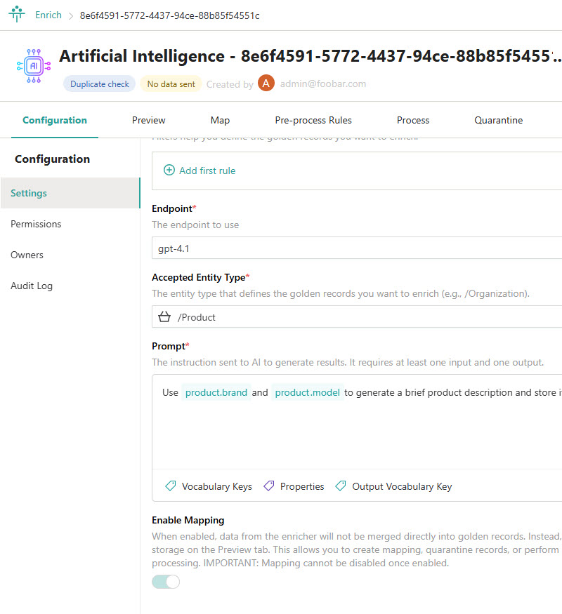


Learn more about AI enricher in our documentation portal.
Next session: Explore the CluedIn AI capabilities.
What’s next?

